Slide 1
Seismology & File Management
By Jiayuan Yao
2020/12/07 NTU

Slide 2
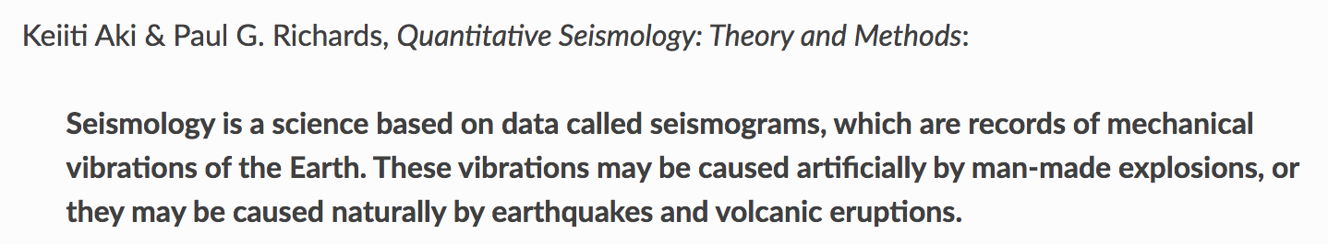
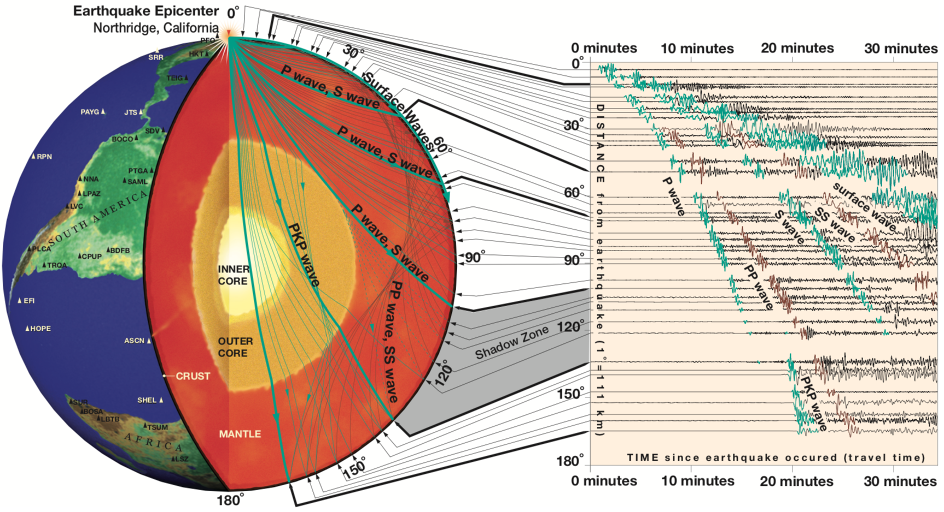
Seismology
https://www.iris.edu/hq/inclass/fact-sheet/exploring_earth_using_seismology

Slide 3
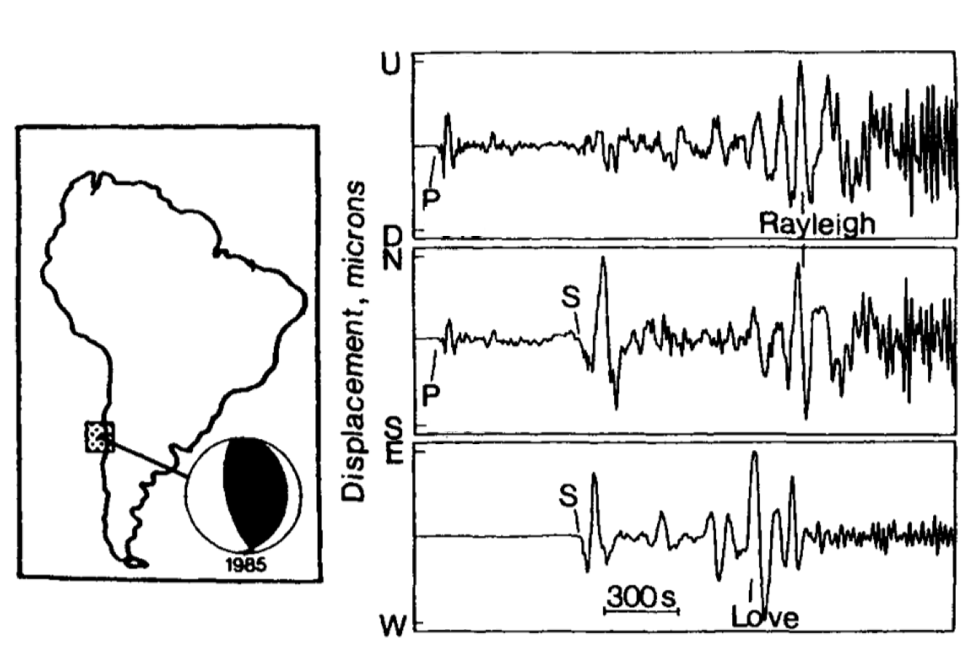
Key Information in Seismic Data
Three-component seismograph (USA)
Key information：
Arrival time
Amplitude
Waveform
South America
Lay & Wallace, 1995

Slide 4
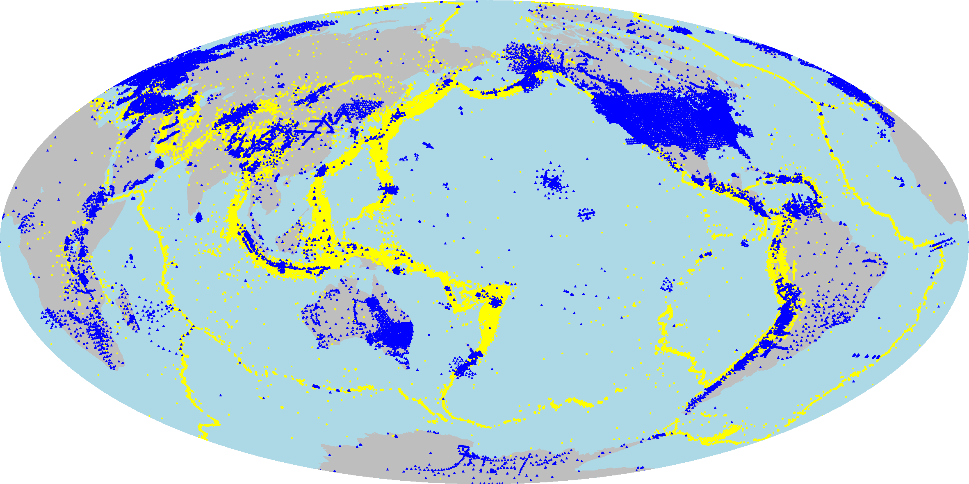
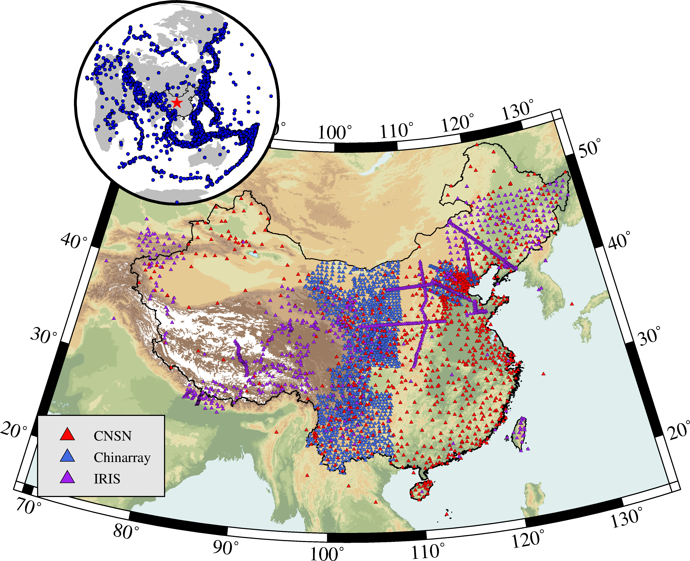
Global Earthquakes and Stations
Seismic Stations
ISC-EHB Earthquakes
Seismic Stations in China

Slide 5
Seismic Source
Seismic source is the source that can cause ground motion recorded by seismic stations:
earthquake (the most common seismic source)
volcano eruption
explosion
ocean waves
wind
human activity (e.g., walking & driving cars)
…
Fundamental source parameters of an earthquake:
origin time: when it occurs
location or hypocenter: longitude, latitude and depth
magnitude: how big it is

Slide 6
Seismic Source
Earthquake Metadata Formats
Format | Feature
text | plain text
csv | “comma separated values” ASCII text
quakeml | a flexible, extensible and modular XML representation of seismological data
geojson | a format for encoding a variety of geographic data structures using the JSON standard
kml | Google’s Keyhole Markup Language
xml | Extensible Markup Language

Slide 7
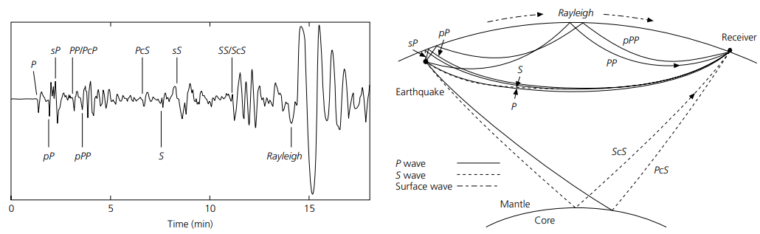
Seismic Wave
Seismic waves are waves of energy that travel through Earth’s interior, and are a result of seismic sources.
There are two kinds of seismic waves:
body waves: seismic waves that move through the interior of the Earth
surface waves: surface waves that travel near the Earth’s surface
Fig. 1.1-3 in An Introduction to Seismology Earthquakes and Earth Structure

Slide 8
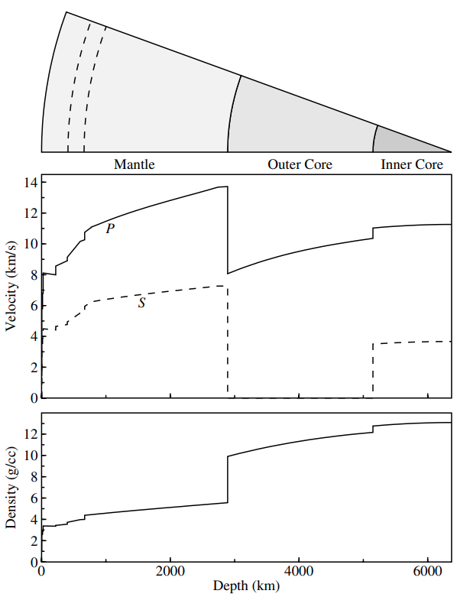
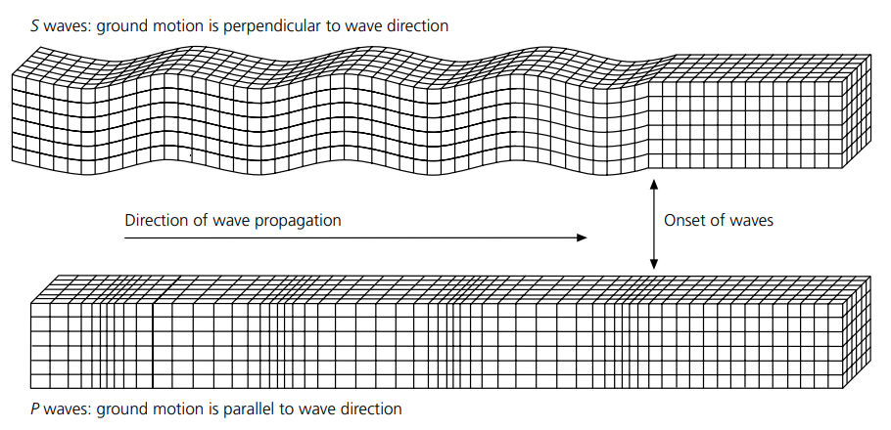
Seismic Wave
There are two kinds of body waves:
P wave: it produces displacement in the direction of wave propagation and a volume change.
S wave: it produces displacement perpendicular to the direction of wave propagation and distort the material without any volume change.
Fig. 2.4-3 in An Introduction to Seismology Earthquakes and Earth Structure
Fig. 1.1 in Introduction to Seismology (2009)

Slide 9
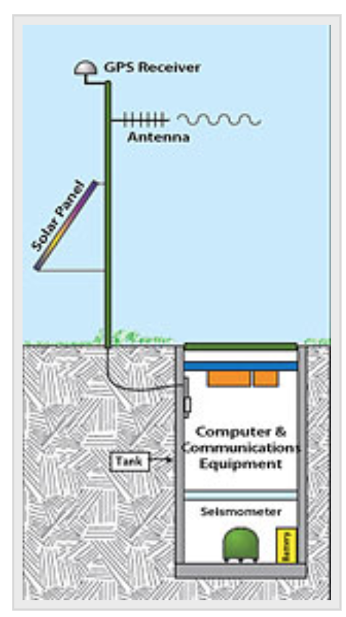
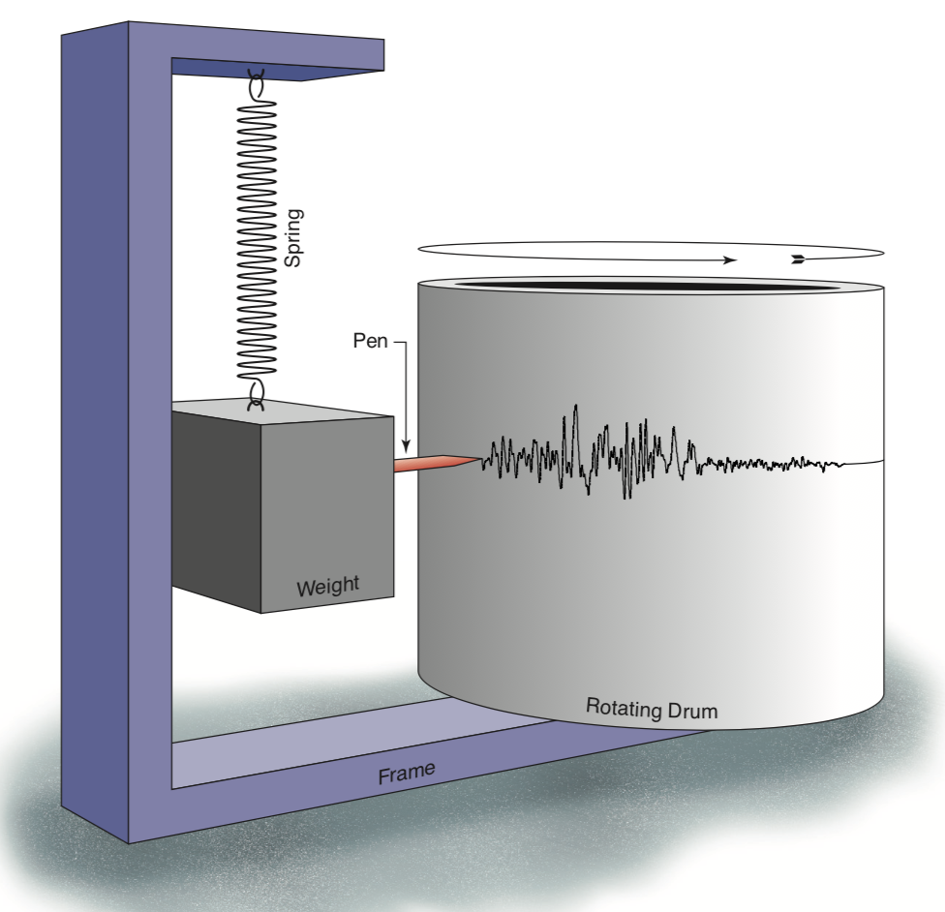
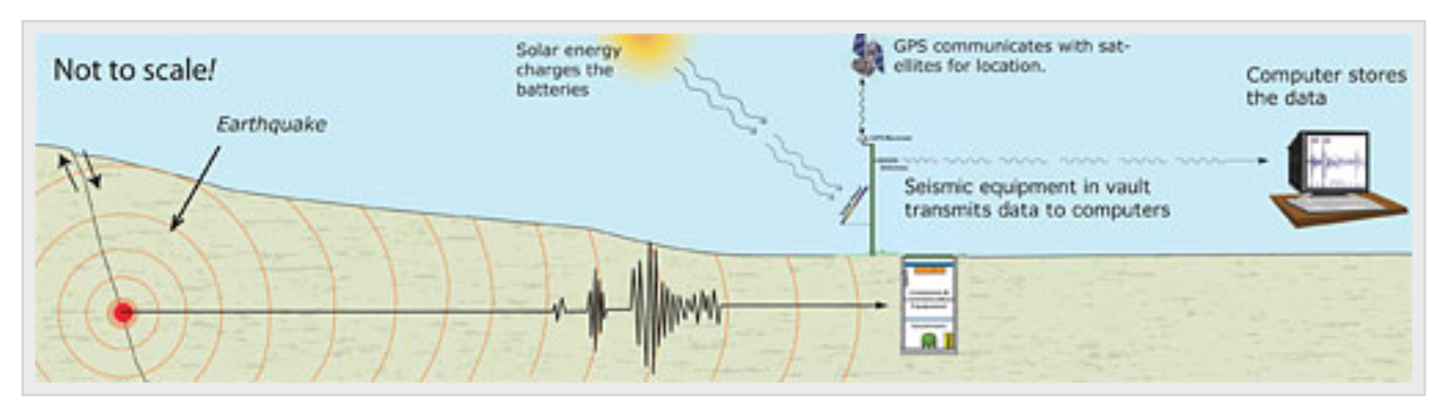
Seismic Station
A seismograph is a device for measuring the movement of the earth.
It consists of a ground-motion detection sensor (called a seismometer) coupled with a recording system (called data logger).
The recorded ground motion is called seismogram.
seismometer
data logger
A cartoon shows how a seismograph works
seismogram
https://www.iris.edu/hq/inclass/fact-sheet/how_does_a_seismometer_work
http://www.usarray.org/public/about/how#anchor1

Slide 10
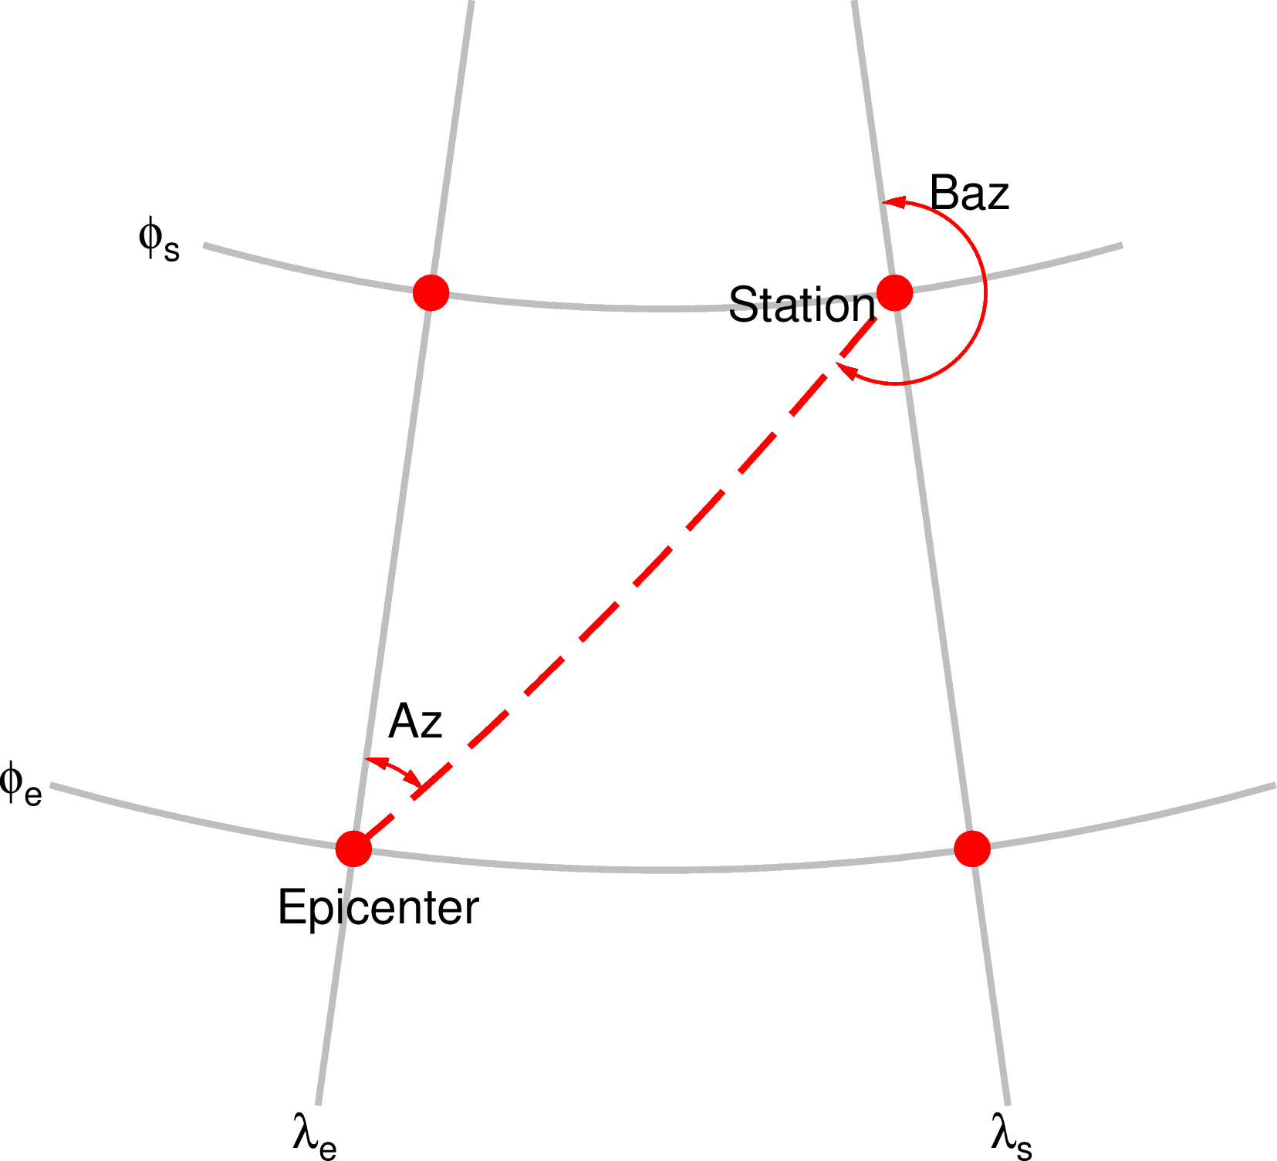
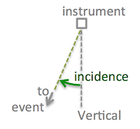
Seismic Station
Great circle arc:
the great circle arc at the Earth’s surface from an earthquake to a station
Azimuth:
the direction from an earthquake to the station measured clockwise from north.
Backazimuth:
the direction from the station towards an earthquake.
Incidence angle:
the angle from vertical at which an incoming ray arrives.
https://seisman.github.io/SAC_Docs_zh/fileformat/header-variables/#gcarc-dist-az-baz
https://service.iris.edu/irisws/rotation/docs/1/help/

Slide 11
Seismic Station
Station Metadata Formats
Format | Feature
FDSN StationXML | a human readable XML representation of SEED 2.4 metadata
Dataless SEED | only station and channel metadata, without any time series data
text | plain text

Slide 12
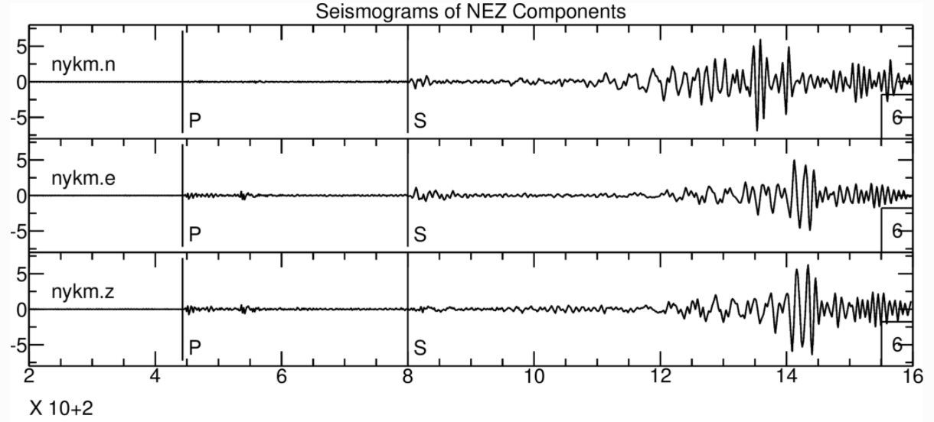
Seismic Data
https://seisman.github.io/SAC_Docs_zh/data-process/rotate/
Seismic Series Data Formats
Format | Feature
SAC | a good format for data analysis, though difficult for storing.
SEED | Standard for the Exchange of Earthquake Data intended primarily for the archival and exchange of seismological time series data and related metadata.
miniseed | the subset of the SEED standard that is used for time series data.

Slide 13
Seismic Data
Seismic Series Data Formats
Format | Feature
SAC | a good format for data analysis, though difficult for storing.
SEED | Standard for the Exchange of Earthquake Data intended primarily for the archival and exchange of seismological time series data and related metadata.
miniseed | the subset of the SEED standard that is used for time series data.
SEED (seismic series data + station metadata) =
miniseed (seisimc time series data) + dataless SEED (station metadata)
Station Metadata Formats
Format | Feature
FDSN StationXML | a human readable XML representation of SEED 2.4 metadata
Dataless SEED | only station and channel metadata, without any time series data
text | plain text

Slide 14
Seismic Data: naming and channels
a SAC file name:
CI.CCC.00.BHZ.SAC
network code
only a suffix
station code
location code
channel code
band code
instrument code
orientation code
Channel code

Slide 15
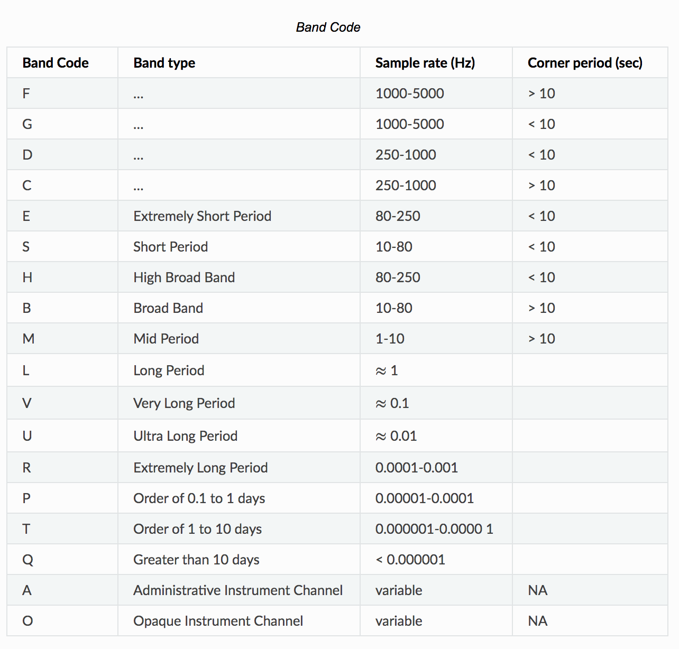
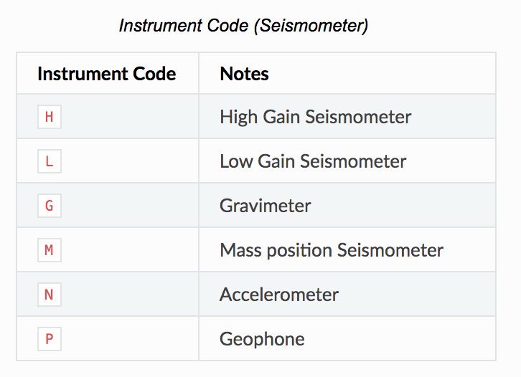
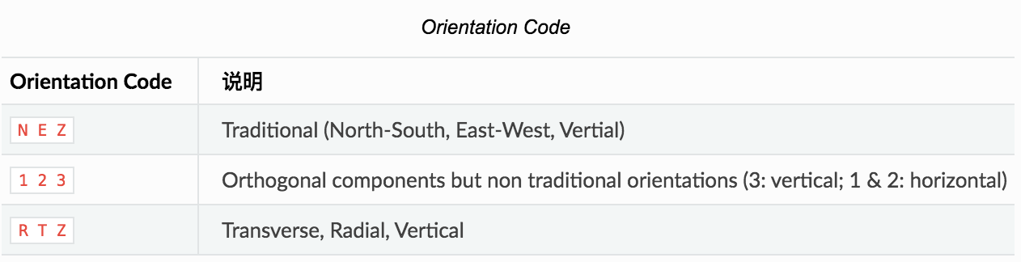
Seismic Data: naming and channels

Slide 16
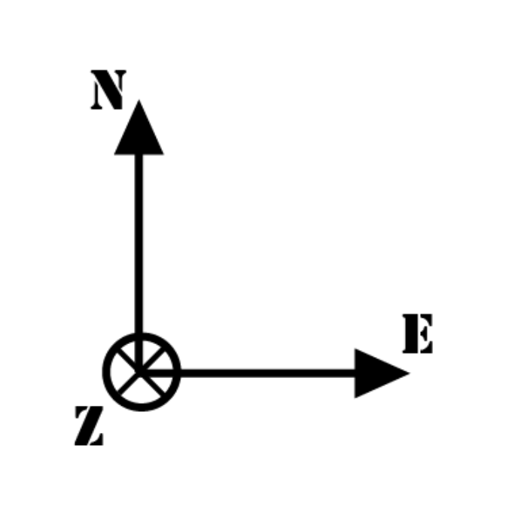
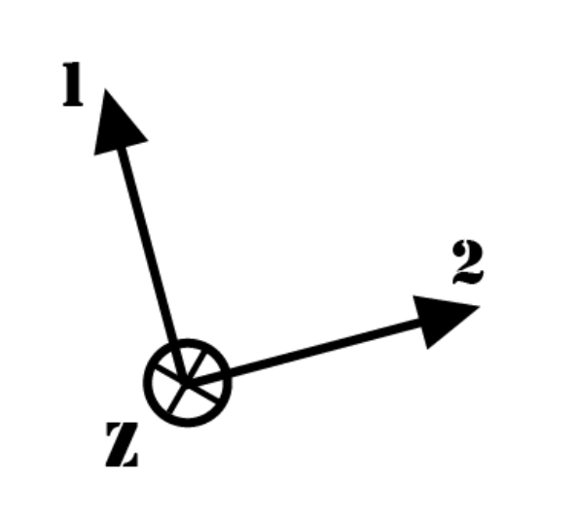
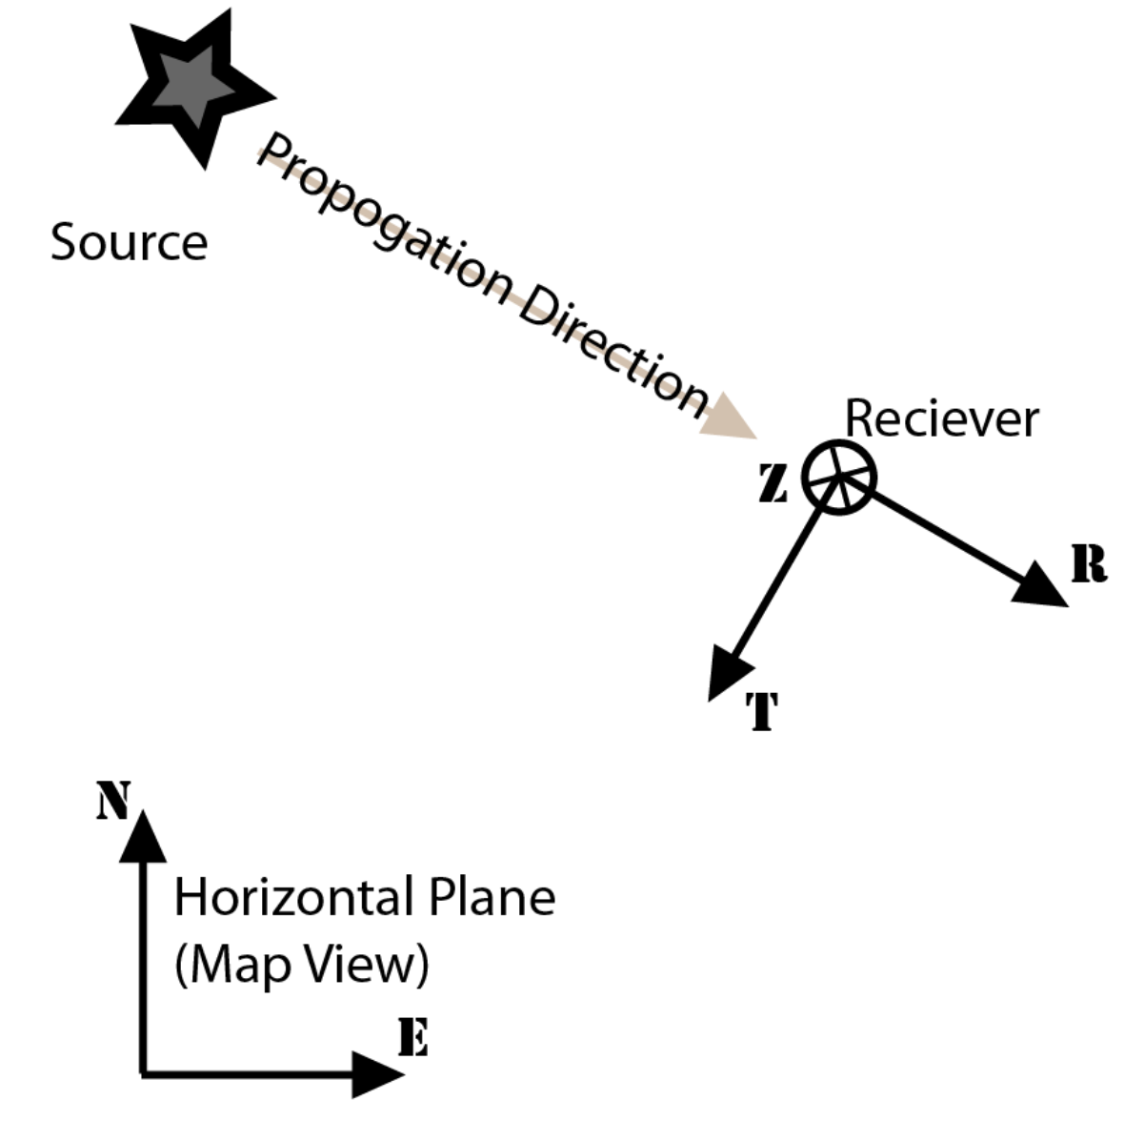
Seismic Data: coordinate systems
NEZ
RTZ
N: north is positive, south is negative
E: east is positive, west is negative
Z: vertical upward is positive
R: pointing from the earthquake to the station
Z: vertical upward
T: perpendicular to the plane of Z and R
12Z
two horizontal components not aligned with North and East.
https://service.iris.edu/irisws/rotation/docs/1/help/

Slide 17
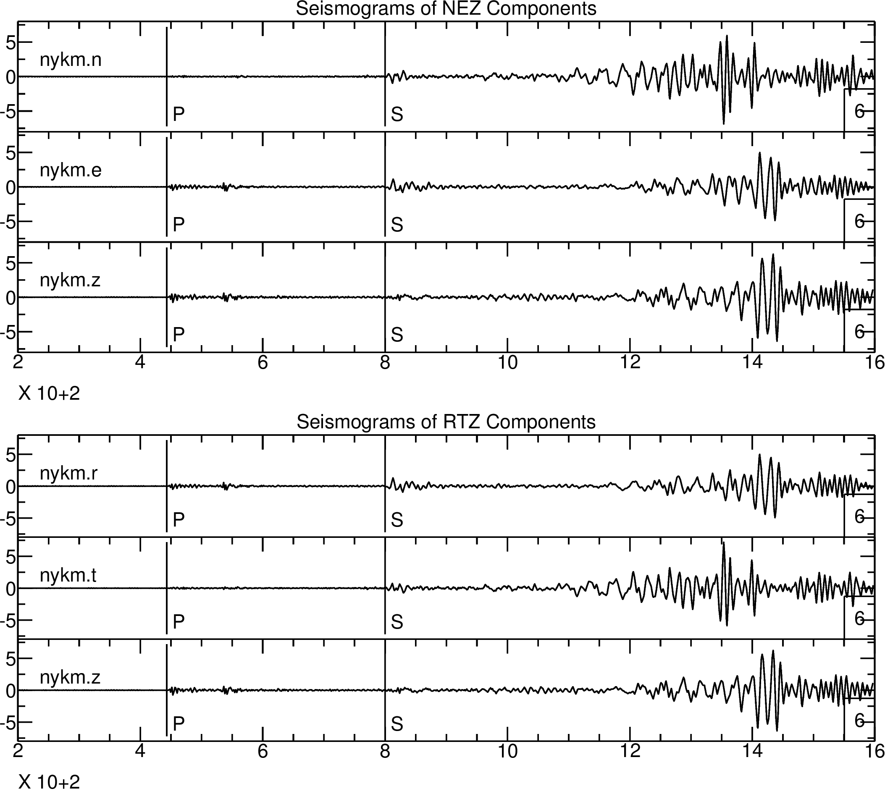
Seismic Data: component rotation
NEZ
RTZ

Slide 18
Seismological Tools
ObsPy: an open-source project dedicated to provide a Python framework for downloading, processing and analysing seismological data
Seismic Analysis Code (SAC): one of the most commonly used seismic data processing and analysis software in seismological community
SOD: a Java program download and pre-process seismic waveform data
TauP: a software to calculate traveltimes of seismic waves trough the interior of the Earth.
GMT: the most commonly used software in geophysics community for plotting high-quality beautiful figures, especially maps

Slide 20
Operating Systems
Microsoft Windows
Apple macOS
Linux (Ubuntu, Debian, Fedora, CentOS, Red Hat, …)
Tips
Seismologists usually use the Linux or macOS operating system
Learn Linux basics instead of a special Linux distribution
Finish the online checklist

Slide 21
File Management
It is very important to learn to how to manage our files!
A bad file management plan:
It will take you a lot of time to find something.
It will slow down your projects.
It will be hard for other people to cooperate with you.
It is very dangerous do researches without backup!!!
Your computer may be broken suddenly.
You may lose your computer by mistake.
You may remove something important by mistake.

Slide 22
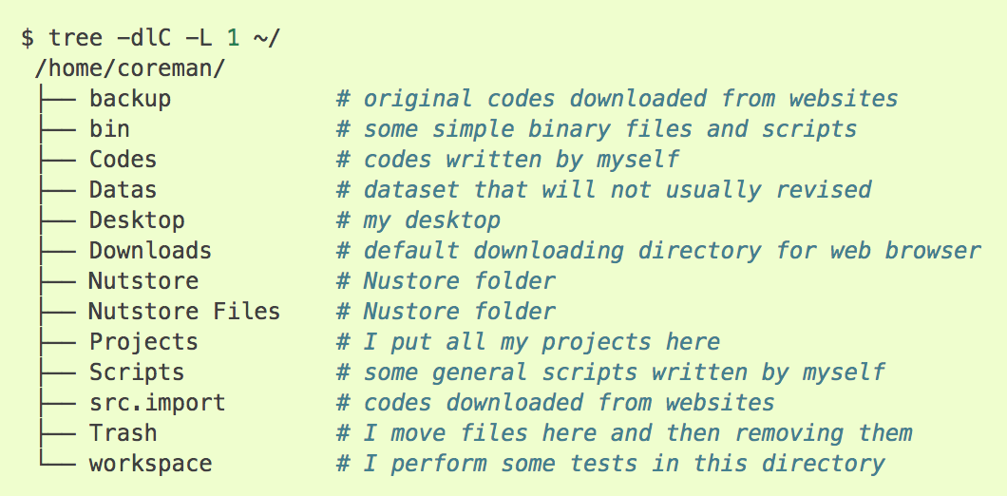
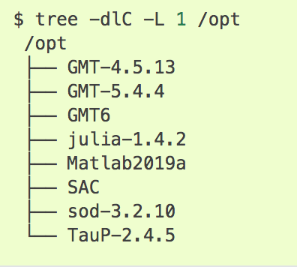
File Management
1. HP workstation: CentOS 7 installed and for researches only.
Home directory
/opt

Slide 23
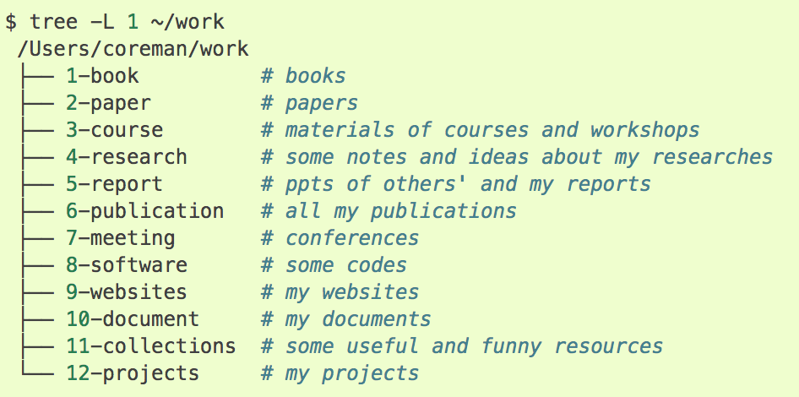
File Management
2. macOS: reading, writing, entertainment and some simple researches
Work directory: ~/work

Slide 24
File Backup
What shall we backup?
Codes
Important documents
Important data
…
Where can we backup the files?
Hard disk
Online storage
How can we backup the files using hard disk?
Linux: rsync
macOS: time machine
Windows: robocopy

